Slide 1
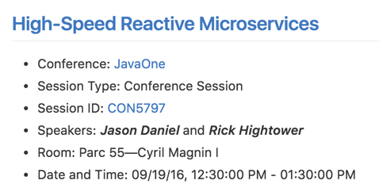

Slide 2
High-Speed Reactive Microservices
Jason Daniel (TWITTER @JasonDaniel44)
Rick Hightower (TWITTER @RickHigh)

Slide 3
Introduction
Jason Daniel
Rick Hightower
Background project we worked
What we are working on now

Slide 4
Overview
Based on Microservices and Reactive programming
Attributes of high speed reactive microservices
Example
How we got here
Single writer
Data ownership and leasing
Service Store
Related tools
(HSRM - High-speed reactive microservices)

Slide 5
Attributes of HSRM
HRSM = (H)igh-(S)peed (R)eactive (M)icroservices
in-memory services
non-blocking
own their data (or lease it)
Scale out often involves sharding services
Reliability is achieved by replicating service stores
Calls to other services and service stores are streamed and/or batched
Implement bulkheads and circuit breakers
Handle back pressure
Notes:
High speed services have the following attributes:
High speed services are in-memory services
High speed services do not block
High speed services own their data
Scale out involves sharding services
Reliability is achieved by replicating service stores
Calls to other services and service stores are streamed
Bulkheads - errors within one service do not escalate to other services. No cascading failures. Opportunity to recover or continue in deprecated mode or both.
Handle back pressure
An in-memory service is a service that runs in-memory. An in-memory services is non-blocking. An in-memory service can load its data from a central data store. In-memory services can load data it owns asynchronously and does not block. It continues to service other requests while the data is loading. It streams in data from its service store whenever leased data is not found, i.e., it faults the data into the services in streams.
At first blush it appears that an in-memory service can achieve its in-memory from using a cache. This is not the case. An in-memory service can use caches but and in-memory service owns its core data. Cached data is only from other services that own their data.
Services should not have strict dependencies with other services to prevent cascading failures
Services should be smart enough to throttle request when resource consumption is high

Slide 6
Advantages HSRM
Cost - less servers or less cloud resources
Deliver more with same amount of developers
Embrace OOP, data and logic live together
Cohesive code base
Ability to react to service calls
Expect to write less code and for it to run faster
Notes:
The beauty of high-speed microservices is it gets back to OOP roots where data and logic live together in a cohesive understandable representation of the problem domain, and away from separation of data and logic. Since data lives with the service logic that operates on it. Also less time is spent dealing with cache coherency issues as the services own or lease the data (own for a period of time). The code tends to be smaller to do the same things.
You can expect to write less code. You can expect the code you write to run faster. To a true developer and software engineer this is a boon. Algorithm speed matters again. It is not dust on the scale while you wait for a response from the database. This movement frees you to do more in less time and to have code that runs orders of magnitudes faster than typical IO bound, cloud lemming services.

Slide 7
High speed services employ the following
Timed/Size Batching
Reduce thread hand-off, sync.,
Optimize IO throughput
Streams
Callbacks / Promises / Async call coordination
Call interception to enable data faulting from the service store
Data faulting for elasticity (like memory paging)
like OS virtual memory (loads parts of file into RAM when it finds it is not loaded)
Call comes in, call queued, user not loaded, user loaded from service store in next batch, call continues
Notes:
High speed services employ the following:
Timed/Size Batching
Streams
Callbacks
Call interception to enable data faulting from the service store
Data faulting for elasticity
Data should be batched and delivered in intervals or based the size of the data.
Streaming data can be used for achieving real time data processing and limit resource overhead. 200,000 request per second. 200,000 calls to the backend service would not scale. 200 calls batched performed a lot better.
Services use callbacks/promises to avoid blocking. Even callbacks are batched.
Call interception similar to AOP in Recommendation Service. Asynchronous data load from service store if user was not loaded into the Recommendation Service.
Data Faulting - Call interception process and the ability to stream the users fast enough so we can survive under load.
Data faulting and data leasing seem a lot like caching. The key difference is ownership of data and the single writer principle.
Imagine a mobile app with a set of services that contains user data. The first call to any service checks to see if that user’s data is already loaded in the service. If the user data is not loaded into the service than the call from the mobile app is put into a queue and the call is not handled until the user data to gets loaded asynchronously. The service continues to handle other calls and the service gets notified when the user data loads, and executes the call on the user data load event then. Since we can get many calls to load user data in a given second, we do not load each user one at a time but we load 100 user at a time or 1000 users at a time or we batch load all requests every 50ms (or both) of all user requests in that time. Loading the user data when it needed is called data faulting. Loading 1000 of users at a time or all users in the last 50ms or all users since the last user load is called batching request. The calls are sent async in a continuous stream. Batching/streaming requests is combining many requests into a single message to optimize IO throughput. Data faulting is the same way your OS loads disk segments into memory pages for virtual memory.
Data faulting - grab data from service store, service call is not responded to until data comes from service
Similar to how OS loads disk segments into memory
Service Store is the disk, service is the app that needs to read a segment of data
Stream/Batch requests to backend

Slide 8
Call speed, non-blocking calls
Streams, pipes, sockets
Bi-directional async communication
For speed, prefer RPC calls that are non-blocking and can be sent in batches (POST or WebSocket or Streams)
Dumb fast pipes and batching calls or streams of calls
Reactive programming
Notes:
Call speed, non-blocking calls
One of the issues with remote calls is speed. This is why you will want to organize services around a domain that will help keep the data for that service with that service and it will not need to interact with other services or a foreign database every time it gets a request for its data. While remote calls are expensive this can be accommodated for by using async calls, batching, and WebSocket/JSON (Reactive Programming Microservice Java Lib) . Remember WebSocket allows bi-directional communication. For speed, you should prefer RPC calls that are non-blocking and can be sent in batches (POST or WebSocket). If you are able to handle requests in streams in an async manner and utilize the hardware efficiently, then you might be doing microservices development.
Another approach for increasing remote call speed is to go all SOA on your API and focus on coarser-grained responses, but this is almost always a mistake. You can write coarser-grained HTTP APIs so more is delivered with each call. This is a problem because it is harder to write and use coarser-grained HTTP APIs as they often conflate many subdomain data in the same call in the name of speed and aggregation. It is easier to batch many smaller calls and create service aggregators. You will need to do both batching and aggregation of domains (coarser grained). Dumb fast pipes and batching calls (turning them into streams) are a good indication that what you wrote is a microservice. Some call this style reactive programming.
Depending on scalability needs services may need be sharded. While a service runs in a single process for scalability that service may really be running in many processes on many virtual machine. Microservices are not stateless. Microservices should own their data. This may mean a private database. This may mean using a data lease model for elasticity. Or a private database shard per sharded service. We will talk more about this later. To learn more about how to scale microservices check out high-speed microservices. To learn more about what a Java microservice looks like read rise of the machine.
If your service is getting all of its data from a database that is shared by one or more web applications, and/or other services and/or other application, then you did not write a microservice. If you service is 100% stateless, then what you wrote is not a microservice.
Microservices do not negate the need for having libraries. If you are making many calls to a microservice, there is an indication that you maybe needed a library instead of a microservice. Adopting microservice architecture does not make you a better systems engineer. You will need some common sense, systems knowledge and/or a very good perf testing regiment. Many will fail and go back to a traditional three tier, web development version of services or some form of enterprise SOA or write a more traditional stateless web service.

Slide 9
Reactive Manifesto and HSRM
Responsiveness
No hanging, no cascascading failures
Resilience
Service Discovery, Health checks , Reconnect, Recover (Mesos), no SPOF
Elasticity
Find new services, scale, shard, discovery, grow
Message driven
Streams, back pressure, async
Notes:
Reactive Services, Reactive Manifesto and Microservices
Many disciplines of software development came to the same conclusion. They are building systems that react to modern demands on services. Reactive services live up to the Reactive Manifesto. Reactive services are built to be robust, resilient, flexible and written with modern hardware, virtualization, rich web clients and mobile clients in mind.
The Reactive Manifesto outlines qualities of Reactive Systems based on four principles: Responsive, Resilient, Elastic and Message Driven.
Responsiveness means the service should respond in a timely manner, and never let clients or upstream services hang. A system failure should not cause a chain reaction of failures. A failure of a downstream system may cause a degraded response, but a response none-the-less.
Resilience goes in line with responsiveness, the system should respond even in the face of failure and errors in a timely fashion. It can respond because it can detect an async response is not coming back in time and serve up a degraded response (circuit breaker). It may be able to respond in spite of failure because it can use a replicated version of a failed downstream node. Failure and recovery is built into the system. Monitoring and spinning up new instances to aid in recovery may be delegated to another highly available resource. A key component of resilience is the ability to monitor known good nodes and to perform Service Discovery to find alternative upstream and downstream services.
Elasticity works with resilience. The ability to spin up new services and for downstream and upstream services and clients to find the new instances is vital to both the resilience of the system as well as the elasticity of the system. Reactive Systems can react to changes in load by spinning up more services to share the load. Imagine a set of services for a professional soccer game that delivers real time stats. During games, you may need to spin up many services. On non-game times, you may need just a few of these services. A reactive system is a system that can increase and decrease resources based on demand. Just like with resilience, Service Discovery aids with elasticity as it provides a mechanism for upstream and downstream services and clients to discover new nodes so the load can be spread across the services.
Message Driven: Reactive Systems rely on asynchronous message passing. This established boundaries between services (in-proc and out of proc) which allows for loose coupling (publish/subscribe or async streams or async calls), isolation (one failure does not ripple through to upstream services and clients), and improved responsive error handling. Having messaging allows one to control throughput (re-route, spin up more services) by applying back-pressure and using back pressure events to trigger changes to shape traffic though the queues. Messaging allows for non-blocking handling of responses.
A well written microservice is more often than not going to apply the principles of the reactive manifesto. One could argue that a microservices architecture is just an extension of the reactive manifesto that is geared towards web services.
There are related subjects of reactive programming and functional reactive programming which are related to the reactive manifesto. A system can be a reactive system and not use a reactive programming model. Reactive programming is often used to coordinate asynchronous calls to multiple services as well as events and streams from clients and other systems.
An example: Client calls Service Z. Service Z calls Service A and Service B, but sends back only the combined results of Service A and Service C. The results of Service B are used to call Service C. Thus Z must call A, B, take the results of B and calls C, then return A/C combined back to the client. And, all of these calls must be asynchronous, non-blocking calls, but we should be able to handle errors for A, B or C, and handle timeouts such that the Client does not hang when Z calls downstream services. The orchestration of calling many services requires some sort of reactive programming coordination. Frameworks like RxJava, RxJS, etc. were conceived to provide an Object Reactive programming model to better work in an environment where there are events, streams and asynchronous calls.
QBit also provides a Reactor class to coordinate asynchronous calls using reactive programming and it uses Java 8 Lambda expression to aid in this endeavor. QBit, Java microservice lib, is a Java-first reactive programming environment that focuses on events, service discovery, and microservices. It implements active object pattern, similar to Akka typed-actors, which is a service which lives behind a set of queues to handle events, method calls, responses, callbacks, etc. These services have location transparency as they can be in-proc of on another server node via WebSocket or the event bus. The resilience comes from replication which is readily possible with the service discovery and the event bus. The service discovery mechanism takes health of the nodes into consideration so unhealthy nodes are taken out of the service pools. QBit implements all the important parts of what it takes to build a reactive system of microservices in Java 8. QBit provides a natural environment to do reactive system development in Java. QBit is a reactive Java lib as well as a microservice lib.

Slide 10
Example

Slide 11
Example Recommendation Service
Recommendation service
Watch what user does, then suggest recommended items
100 million users
Recommendation engine can run about 30K recommendations per second per thread
We run 8 to 16 recommendation engines per microservice (240K to 480K recommendations per second)
Each recommendation service can handle 200K requests per second
Does event tracking which is not CPU bound
Does a large calculation which is a big N+1 * N+1 in memory comparison

Slide 12
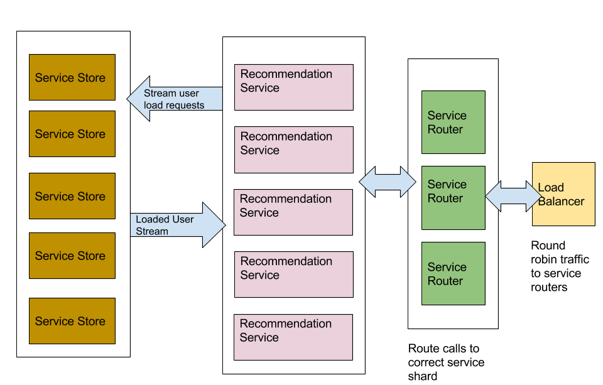
Block diagram of a HSRM system we built

Slide 13
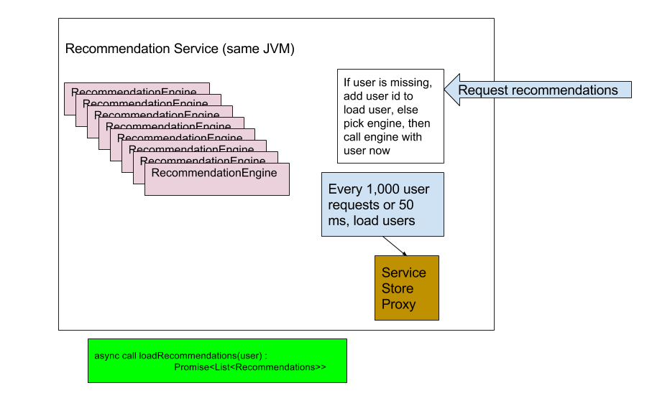
Call to service is queued and replayed after user is loaded
Service Store

Slide 14
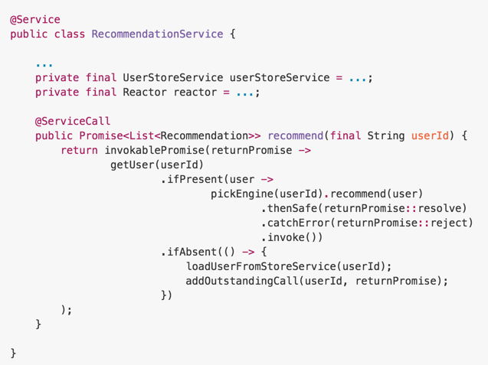
Async call recommendation engine if user present
If not add user id to call batch, add to outstanding call for user.

Slide 15
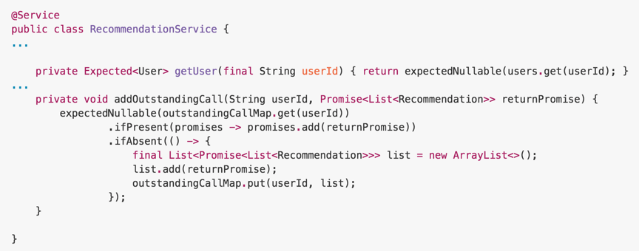
Adding an outstanding call (promise)

Slide 16
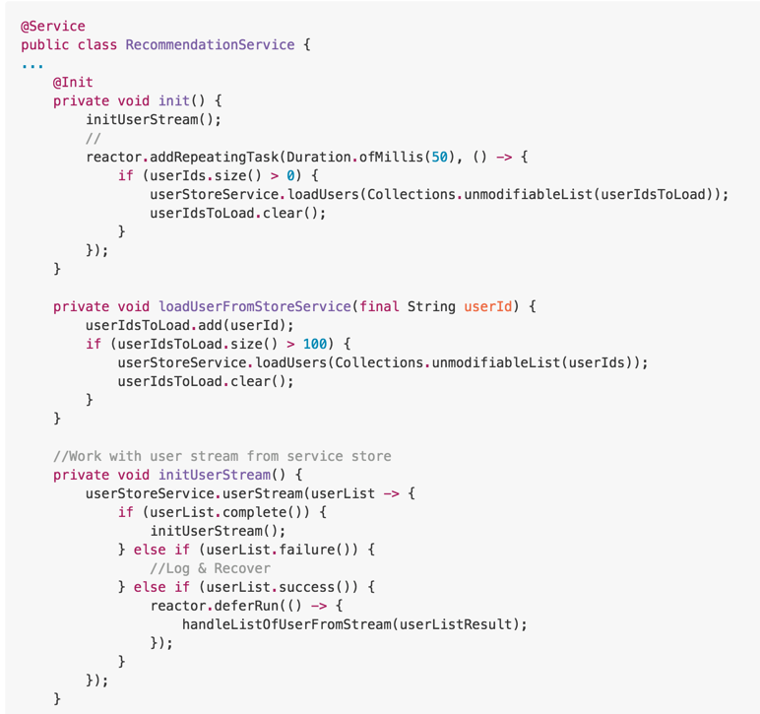
Every 50 ms check to see if the
userIdsToLoad is greater than 0,
If so request those users now.
When a user is not found loadUserFromStoreService is called. If there are 100, outstanding requests, then load those users now.
Listen to the userStoreService’s
userStream

Slide 17
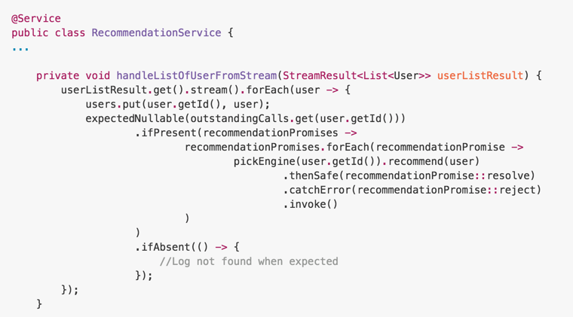
Process the stream result.
Populate the user map (or use a Simple cache with an expiry and a max number of users allowed to be in system).
Since the user is now loaded, see if their are outstanding calls (promises) and resolve those calls.

Slide 18
How we got here. Why High Speed Microservices?
Notes:
Each slide in this section is to be covered quickly. No more than 30 seconds per slide.

Slide 19
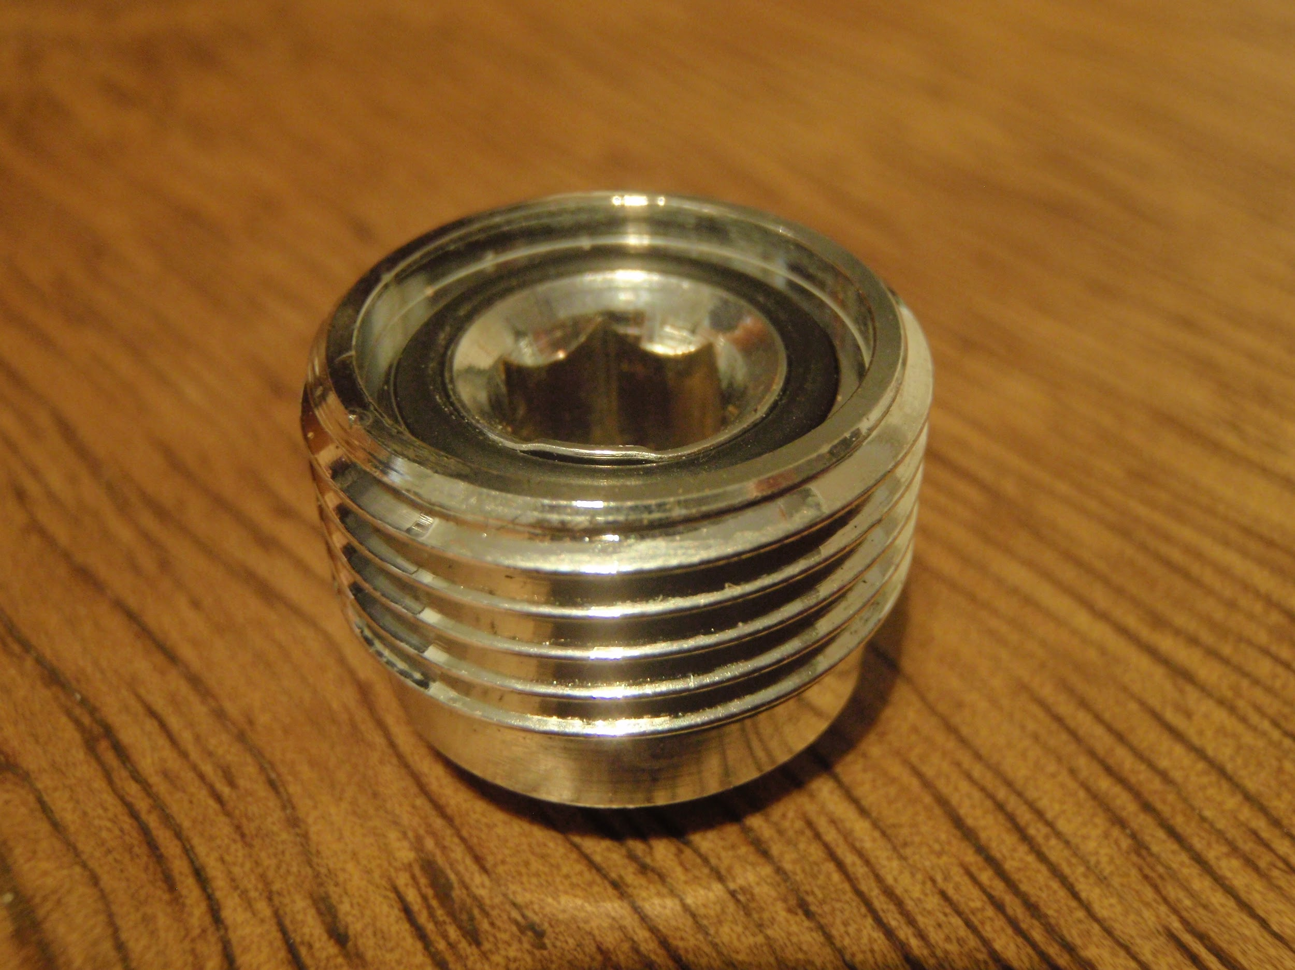
Our interests, background, experience
Been studying high-speed computing (mechanical sympathy)
Working with a media company that built services that can have 100 million users
Worked with Actor systems before
Interest in creating bounded services which could be more accurately bid for fixed bid projects and/or just better project management
Remote, focused, disparate teams with different experiences and talents working on the same project.
Experience: We were key members on a team that built a 100 million users microservice
Notes:
Drill down on why fixed bidding is important for consulting and also good for a project.

Slide 20
Need for speed
Large media company
Very spiky traffic
100 million users
Mobile (iOS, Android), game console, Tivo, AppleTV, etc.
Existing services handling less traffic using 1,000 of servers
Many services hiding behind CDN (updates take a while)
Had mandate to deliver services that could stand up to load and not cost a fortune to run
Notes:
The headline is the slide, briefly cover the concepts.
Results can comeback on foreign threads If you need to call several services, what if one of them fails or times out? What if you need to combine the results of several calls before you can respond to the caller? What if a downstream service goes down? What if your async handler throws an exception? If you use a blocking future, you can tie up the event handling thread How do you test async services with a unit test framework?
Talk about F5. Cloud Load Testing. Largest traffic spike. Almost taking out the F5.

Slide 21
Reactor Pattern
Reactor pattern:
event-driven,
handlers register for events,
events can come from multiple sources,
single-threaded system
handles multiple event loops
Can aggregate events from other IO threads
Notes:
“The reactor design pattern is an event handling pattern for handling service requests delivered concurrently to a service handler by one or more inputs. The service handler then demultiplexes the incoming requests and dispatches them synchronously to the associated request handlers.” https://en.wikipedia.org/wiki/Reactor_pattern
“The Reactor pattern has been introduced in [Schmidt95] as a general architecture for event-driven systems. It explains how to register handlers for particular event types, and how to activate handlers when events occur, even when events come from multiple sources, in a single-threaded environment. In other words, the reactor allows for the combination of multiple event-loops, without introducing additional threads.” http://www.cs.vu.nl/~eliens/online/oo/I/2/reactor.html

Slide 22
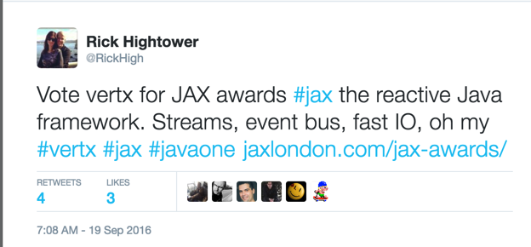
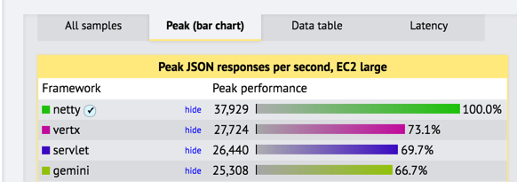
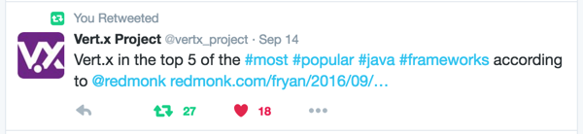
Implementations of Reactor Pattern
Browser DOM model and client side JavaScript
Node.js - JavaScript
Vert.x - Java (Netty also Java)
Spring 5 - Reactor (not then)
Java EE - Reactive/Microservice focus
Twisted - Python
Akka's I/O Layer Architecture - Scala
Swing/GTK+/Windows C API
Reactor pattern frameworks do good in the IO performance wars and are typically at the top of the Techempower benchmarks
Notes:
At the time that we started our journey with reactive programming, we were looking for a fast, Java server-side framework.
We were working on an in-memory recommendation engine for 100 million user system which consisted of a set of applications for web, iphone, android, xbox, and AppleTV apps.
Vert.x was 3rd overall, and then later it was 2nd overall. Netty was Java 6 based for the most part, and Vert.x gave us speed with some ease of use.
We picked Vert.x because it was Java and it was fast and we had to handle a large number of connections of varying degrees of speed with a rate of about 150K to 200K requests per server.
We ended up creating a system that could handle more traffic on 13 servers than a previous similar system could handle on 2,000 servers.
Before this we worked on high-traffic messaging systems and even actor systems. We were both familiar with complex, high-speed, call coordination.

Slide 23
Why High-speed reactive microservices?

Slide 24

Scale out model / Cloud model
Performance issue, run more instances
Knee jerk reaction for some is to address every performance issue with adding more nodes, more cache, more resources
Every perf issue can be addressed with same hammer
But 2,000 boxes are harder to support than 20 or 10 not to mention costs
Scale issue, run more instances
This works but at what cost?
More cost
More reliability, but more complexity
Move towards scale up and out (more with less)

Slide 25
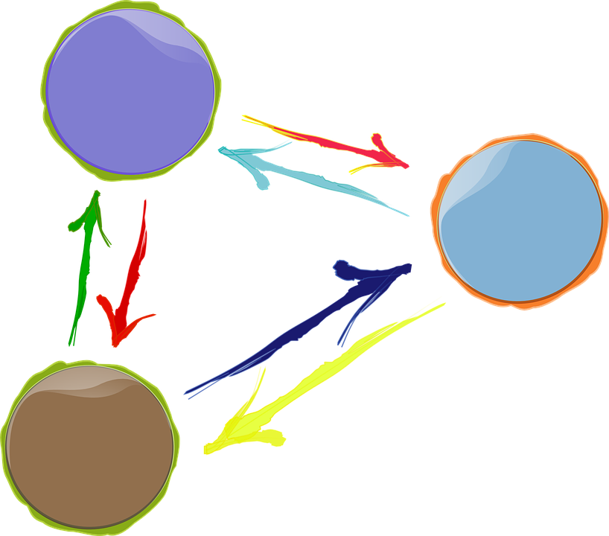
Advantages of high-speed microservices
Observed
Less developer resources
Less hardware/cloud resources
Handle more traffic
Cheaper operation costs
100 million user service. Using a high-speed microservice architecture design, we created a system that handled more load on 13 servers than another similar system at the same company that used 2,000 servers (and needed a costly team to monitor and tweak), and another company in the same industry used 150 servers to handle less traffic with a similar system. Our dev team was smaller. The project had a quicker turnaround time.
Notes:
Using a high-speed microservice architecture we were able to design a system that handles more load on 13 servers than another similar system at the same company that used 2,000 servers (and needed a costly team to monitor and tweak), and another company in the same industry used 150 servers to handle less traffic with a similar system. Our dev team was smaller. The project had a quicker turnaround time.

Slide 26
Reliability vs. operational predictability

Slide 27
Reliability
Replication, fault tolerance, number of nodes
More nodes equates to more reliability but at a cost
How much? Are there diminishing returns?
Reliability is also a function of simplicity and operational predictability
Notes:
The model described in this talk is the inverse of how many applications are built. It is not uncommon to need 3 to 20 servers for a service where in a traditional system you might need 100s or even 1,000s. Your Cloud/EC2 bill could be cut into 1/10th the cost for example. This is not just supposition but actual observation from experience.
In this model, you typically add extra services to enable failover support not to scale out per se. You will reduce the amount of servers needed and your code base will be more coherent if you adopt these strategies.

Slide 28
Cloud myth more nodes = more reliable
True but less nodes also equals more operational predictability and there is diminishing returns with more nodes = more reliability
3 servers with 99% reliability
1 in a million chance all go down (1 in 1,000,000)
5 servers with 99% reliability
1 in a 10 billion chance all go down
Amazon EC2 offers 99.95% SLA. Other clouds offer much higher SLA. Chances are near astronomical that all instances go down at the same time.
Notes:
If your servers have an uptime of 99 percent and you can fail over to three servers than the probability of them all going down at once is (0.000001) so the probability of them all going down is 1 in 1,000,000. Of course uptime of modern operating systems (Linux) is much higher than this so one in 100,000,000 or more is possible with just three servers. Amazon EC2 offers discounts if they can't maintain an SLA of 99.95% (other cloud providers have even higher SLAs). With five servers, the chances of all five of them going down at once, is 1 in 10 billion.
While it is true that more nodes equals more reliability, once you get past 3 to five nodes (assuming they can handle the same traffic), then the reliability increase does not justify the expense.
The biggest issue with cloud deployed application is trying to replicate architecture from the 90s and 2000s-2005s in the cloud. It is costly and complex.

Slide 29
If you can handle all traffic on 1 or 2 nodes
If you can handle all traffic on a few nodes, then you need three to five nodes max for reliability.
If you app is mission critical, this might mean 3 to five nodes in two geographic regions or availability zones.
It never means you need 1,000.
Notes:
In general the cloud scale out model, employs a sense of reckless abandon. If your app has performance issues, no problem spin up 100 servers. Still not fast enough. Try 1000 servers. This has a cost. This does not replace a cloud scale out model per se. It just makes a cloud scale out model more cost effective. Do more with less.
This is not to say that there are not advantages to the cloud scale out model. This is to say that an ability to do more with less hardware has cost savings, and you can still scale out as needed in the cloud.

Slide 30
Reactive, Reactor and Reactive streams

Slide 31
HSRM need reactive programming
Reactive frameworks
Reakt, Streams, Vert.x, Baratine, Akka, Netty, Node.js, Go Channels, Twisted, QBit Java Microservice Lib, Spring 5 reactive, Java 9 Flow, RxJava, Java EE (Java-RS, Servlet Async, WebSocket), JavaOne Keynote: JavaEE getting reactive, etc.
Tools that can really help
Kafka, Kinesis, JMS, Sockets, Streams
12 factor services, Monitoring and alerting, containers, Mesos/Kubernetes, CI, etc. but that is just normal microservice accompaniments.
Notes:
There are many Java frameworks and libraries for microservices that you can use to build a high speed microservice system. Vertx, Akka, Kafka, Redis, Netty, Node.js, Go Channels, Twisted, QBit Java Microservice Lib, etc. are all great tools and technology stacks to build these types of services. This talk is not about any particular technology stack but a more abstract coverage of what it means to build these type of high speed services devoid technology stack preference.
You could use tools like a Java EE stack or Akka/Logjam. We did end up using Vert.x and we developed QBit out of our experience with Vert.x

Slide 32
Reactive programming
Reactive Manifesto - what is it and why it matters
Reactor Pattern
Microservices
Async programming prefered for resiliency
Avoiding cascading failures (“synchronous calls considered harmful”)
Async programming - key to all
Even method calls and results can be streamed
Notes:
The point of this slide and the next is to make the claim that streaming is not the only way to do reactive programming.
The most common form of reactive programming is the reactor pattern / event loop, i.e., Browser DOM, Node.JS, Twisted and Vert.x.
Streaming fits many problem domains but so do service calls which are also more common.
Also streaming can be an implementation detail (as you can stream calls and stream responses).
If streaming is not the only way to handle async programming and not even the most common, what / how to people do service style programming and what tools do they use.
Node.js and Browser DOM JS are the two most common forms of async programming and they use Promises.
Akka has promises, Netty has promises, Vert.x has async result which is similar and QBit had something like promises before Reakt.
Reakt attempts to be separate from any particular implementation to focus on being a good promise lib for any sort of async programming in Java.
From Microservices paper by Martin Fowler et al: “Synchronous calls considered harmful: Any time you have a number of synchronous calls between services you will encounter the multiplicative effect of downtime. Simply, this is when the downtime of your system becomes the product of the downtimes of the individual components. ...” http://martinfowler.com/articles/microservices.html

Slide 33
Streams vs Async Service Calls
Microservices / RESTful services / SOA services
REST / HTTP calls common denominator
Even messaging can be request/reply
Streams vs. Service Calls
Level of abstraction differences,
Calls can be streamed, Results can be streamed
What level of abstraction fits the problem you are trying to solve
Are streams a implementation details or a direct concept?
Notes:
The point of this slide and the previous is to make the claim that streaming is not the only way to do reactive programming.
The most common form of reactive programming is the reactor pattern / event loop, i.e., Browser DOM, Node.JS, Twisted and Vert.x.
Streaming fits many problem domains but so do service calls which are also more common.
Also streaming can be an implementation detail (as you can stream calls and stream responses).
If streaming is not the only way to handle async programming and not even the most common, what / how to people do service style programming and what tools do they use.
Node.js and Browser DOM JS are the two most common forms of async programming and they use Promises.
Akka has promises, Netty has promises, Vert.x has async result which is similar and QBit had something like promises before Reakt.
Reakt attempts to be separate from any particular implementation to focus on being a good promise lib for any sort of async programming in Java.

Slide 34
Rules of the Road for HSRM

Slide 35
Single writer rule - in-memory
Data ownership (or lease)
Ownership update data
Services own data for a period of time (lease)
Only one service can write data to a domain object (or set of domain objects)
Reduces Cache inconsistencies (root of evil and complexity)
Best way to keep data in sync is do not use cache for operational data
Caches are used but for caching data from other services (if needed)
Uses a service store (which is a streaming store for service domain data)
Data lease
User not edited after ½ hour evicted (configurable)
Every update renews lease
Each node has max number of users store LRU (for reshuffle)
Users are batch requests and then batch streamed into Service
Notes:
Single writer rule: Only one service at any point in time can edit service particular set of service data
In-memory services either own their data or own their data for a period of time. Owning the data for a period of time is a lease model.
Think of it this way. Data can only be written to by one service at any given point in time. Cache inconsistencies and cache control logic is the root of all evil. The best way to keep data in sync with caches is to never use caches or use them sparingly. It is better to use a service stores that can keep up with your application vending the data as needed in a lease model. Or to create longer leases on service data to improve speed. More on leasing and service stores is described later.
LRU cache and also an eviction policy for users that had no activity for 30 minutes
Operational data - data needed to run a service ie user, preferences

Slide 36
Avoid the following for High-Speed
Caching (use sparingly)
Blocking
Transactions
Databases for operational data (in direct line of fire)
Operation data is user and data we are tracking for recommendations
Operation is data to run the service
Operation data is not data for reports, offline analytics
Notes:
Avoid the following:
Caching (use sparingly)
Blocking
Transactions
Databases for operational data
Transaction alternatives
Pre-ack, then execute (can be async)
Remediation queue
Bundle request in persistent queue and run transaction out of process

Slide 37
Embrace the following for High-Speed
In-memory service data and data faulting
Sharding
Async callbacks
Replication
Batching / Streaming
Remediations
Messaging/Streaming data(Kafka, Kinesis, etc.)
Service Stores for operational data
Transaction alternatives
Async, Pre-ack, then execute (async)
Remediation queue
Bundle request in persistent queue and run transaction out of process
Notes:
Embrace the following:
In-memory service data and data faulting
Sharding
Async callbacks
Replication / Batching / Remediations
Service Stores for operational data

Slide 38
Service Sharding / Service Routing
Elasticity is achieved through leasing and sharding
A service server node owns service data for a period of time
All calls for that user’s data is made to that server
In front of a series of service servers is a service router
A service router could use a sticky simple round robin, consistent hash affinity based on a header or a more complex approach with more knowledge about back end services
Important part is you can add more back end services if needed and rely on lease expiration or an event to notify the service which data set/shard it is handling
Sticky IP round robin for a simple case or userId in HTTP header (sticky)
Notes:
Service Sharding / Service Routing
Elasticity is achieved through leasing and sharding. A service server node owns service data for a period of time. All calls for that user’s data is made to that server. In front of a series of service servers is a service router. A service router could be an F5 (network load balancer) that maintains server/user affinity through an HTTP header. A service router could be a more complex entity that knows more about the problem domain and knows how to route calls to other back end services.

Slide 39
Fault tolerance
More important the data and the more replication and synchronization that needs to be done
More important the data the more resources that are needed to ensure data safety
If a service node goes down, a service router can select another service node to do that work from service discovery
Service data can be data faulted loaded in an async/data faulting/batch to new service
Updates to data can be sent in a persistent streaming/messaging (Kafka, Kinesis, JMS)
Notes:
Fault tolerance
The more important the data and the more replication and synchronization that needs to be done. The more important the data the more resources that are needed to ensure data safety.
If a service node goes down, a service router can select another service node to do that work from the service discovery. The service data will be loaded in an async/data faulting/batch. If the service was sending updates to changes then no state is lost except the state that was not sent to the service store since the last update, and if you are streaming updates via for example Kafka to the service store this may equate to no data loss. The more important the state/data, the more synchronization that should be done when the data is modified. For example, the service store can send an async confirmation of a save, the service could enqueue a response to the client. The client or service tier could opt to add retry logic if it does not get a response from the server. You can also replicate calls to services. You can also create a local store and forward for important calls.
Fault tolerance, service router and service discovery are essential to building a reactive Java microservices architecture.

Slide 40
Data ownership
More data you can have in-memory in the service the faster your services can run
Data ownership means at a given point in time one instance of a service owns a particular domain model object (user, artist, partner, song) or data model object tree (user’s preferences)
Data faulting, and data leasing help services own data and use the single writer rule
Notes:
Data ownership
The more data you can have in-memory the faster your services can run. Not all use cases and data fit this model. Some exceptions can be made. The more important principle is data ownership. This principle comes from the canonical definition of microservices.
In-memory is a means to an end. Mostly to facilitate non-blocking. The more important point is to have the service own the data instead of just being a view into shared data. The more important principle is the single writer principle and the avoidance of cache.
Let's say that some data is historical data, and historical data rarely gets edited, but it does get edited. Then in this scenario it might make no sense at all to not load the historical data from a database and then update the database directly and skip the service store altogether since the usage is rare and unlikely to hamper the overall performance of the system.
If size of the data is an issue remember that you can shard the services and you can also fault data into a service server in batches or streams. These two vectors should allow most if not all of the operational data to be loaded into memory and enable the single writer principle. Think of this as more of the Pareto principle. You don't need all. You just need the set of data in-memory that is going to give you the SLA that you need. All would be nice. But you can only have 20% of the data that is faulted in and still have a really fast system.
A lease can be 1/2 hour, 8 hours, or some other period of time. Once the lease has expired which could be based on the last time that service data was used, then the data just waits in the service store.

Slide 41
Why lease?
If data is small enough one service can own it all, but if that does not make sense
Leasing data provides a level of elasticity
Leasing allows you to spin up more nodes
Data must be loaded from the service store quickly and usually in batches and streams
The Faster you can move data into service, the shorter you can keep a lease
Services can save data periodically to the service store or even stream updates if needed
Expired leases means data has to be reloaded from service store
Expired lease can be like a cache expiry (except lease relies on single writer rule)
Notes:
Why Lease? Why not just own?
Why not just own data out right. Well you can if the service data is small enough. Leasing data provides a level of elasticity. This allows you to spin up more nodes assuming the nodes employ some sort of sharding. If you optimize and tune the data load from the service store to the service then loading users data becomes trivial and very performant. The faster and more trivial the data fault loading, the shorter you can lease the data and the more elastic your services are. In like manner services can save data periodically to the service store (or stream updates if needed) or even keep data in a fault tolerant local store (store and forward) and update the service store in batches to accommodate speed and throughput. Leasing data is not the same as getting data from the cache. In the lease model only one node can edit the data at any given time. Leasing usually employs a cache to evict data whose lease has expired.

Slide 42
Service Store
Vend data quickly
Vend data in streams
Keep most data in-memory
Accept data requests in streams
Service Store is about storing and vending service data
Updates can be in streams
Only for Service operational data
Notes:
The primary store for a high speed service system is a service store. A service store can treat the service data as opaque. A service store is not a database. A service store is not a cache either. A service store may also keep the data in-memory. The primary function of a service store is vending data quickly to services that are faulting data in.
A services store also takes care of data replication for data safety and safe storage. A service store should be able to bulk save data (stream saves) and bulk load data (stream loads) to/from a service and to/from replicas. A service store like the service itself should never block. Responses are sent asynchronously. WebSocket or sockets are a great mechanisms to send responses from a service store to a given number of services. JSON or some form of binary JSON is a good transport and storage mechanism for a service store.
Service stores are elastic and typically sharded but not as elastic as service servers. Service stores employ replication and synchronization to limit data loss. Service stores are special servers so the rest of your application can be elastic and more fault tolerant. It is typical to over provision service stores to allow for a particular span of growth. Adding new nodes and setting up replication is more deliberate than it is with services. The service store and the leasing model is what enables the services to be elastic.
By special servers, we mean service store servers might use special hardware like disk level replication and servers which might employ additional monitoring. All service data saved to a service store should be saved in at least two servers. There is a certain level of replication that is expected. Service stores may also keep a transaction log so that others processes can follow the log and update databases for querying and reporting.
In high-speed services, databases are only for reporting, long term storage, backup, etc. All operational data is kept and vended out of the service stores which maintain their own replication and backups for recovery. All modifications to data is done by services. Service stores typically use JSON or some other standard data format for long term storage for both the transaction logs for storage into secondary databases.
A service store is the polar opposite of Big Data. A service store is just operational data. One could tail the transaction logs to create Big Data.

Slide 43
Service Actors and streams of calls

Slide 44
Active Objects / Threading model
Active object pattern
separates method execution from method invocation
Minimize complex synchronization code
Each active object resides in their own thread of control
Method calls are queued
Akka typed actor model (close) / QBit implements service actors
Queues/messaging are essential to handle back pressure and create reactive services
Notes:
To minimize complex synchronization code that can become a bottleneck one should employ some form of Active Objects pattern for stateful, high-speed services. One could use an event bus system like Vertx or Node.js or an Actor system like Akka or GO channels or Python Twisted and build their own Active Object service system. Queues and messaging are essential if you want to handle back pressure and create reactive applications. Akka has a typed actor model which is very close to an Active Object model.
The active object pattern separates method execution from method invocation for objects that each reside in their own thread of control (or in the case of QBit for a group of objects that are in the same thread of control).
The goal of Active Objects is to introduce concurrency, by using asynchronous method invocation and a scheduler for handling requests. The scheduler could be a resumable thread draining a queue of method calls. This scheduler could also check to see if data needed for this call was already loaded into the system and fault data in from the service store into the running service before the call is made.
The Active Object pattern consists of six elements:
A client proxy to provide an interface for clients. The client proxy can be local (local client proxy) or remote (remote client proxy).
An interface which defines the method request on an active object.
A queue of pending method requests from clients.
A scheduler, which decides which request to execute next which could for example delay invocation until service data if faulted in or which could reorder method calls based on priority or which could work with several related services from one scheduler allowing said services to make local non-enqueued calls to each other.
The implementation of the active object methods. Contains your code.
A service callback for the client to receive the result.

Slide 45
Active Objects consist of six element
A client proxy to provide an interface for clients.
Client proxy can be local (local client proxy) or remote (remote client proxy)
An interface which defines the method request on an active object
A queue of pending method requests from clients
A scheduler, which decides which request to execute next which could for example delay invocation until service data if faulted in or which could reorder method calls based on priority or which could work with several related services from one scheduler allowing said services to make local non-enqueued calls to each other
Implementation of the active object methods. Contains your code.
A service callback for the client to receive the result
Notes:
The Active Object pattern consists of six elements:
A client proxy to provide an interface for clients. The client proxy can be local (local client proxy) or remote (remote client proxy).
An interface which defines the method request on an active object.
A queue of pending method requests from clients.
A scheduler, which decides which request to execute next which could for example delay invocation until service data if faulted in or which could reorder method calls based on priority or which could work with several related services from one scheduler allowing said services to make local non-enqueued calls to each other.
The implementation of the active object methods. Contains your code.
A service callback for the client to receive the result.

Slide 46
What came from this experience

Slide 47
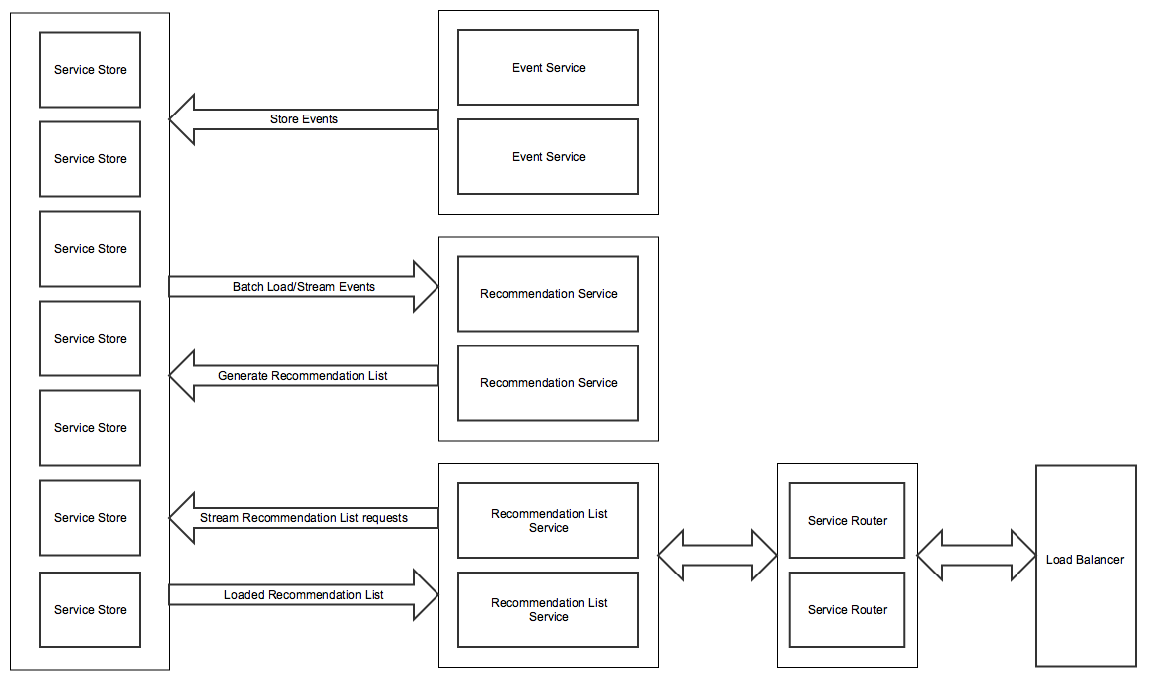
Proposed Version 2
Notes:
asfasd

Slide 48
What came out of it?
We both work with reactive programming on a daily basis
Went on to create other high-speed microservice
Implemented a OAuth rate limiter to limit service calls from partners that sits in front of thousands of backend services
QBit, a microservice service actor framework lib
Reakt, reactive Java promises and stream handling for async call coordination and stream handling.

Slide 49
Related projects
QBit Java Microservice (built on top of Vert.x for IO)
Using Reakt reactor to manage callbacks,
REST and WebSocket services (WebSocket RPC) use Reakt Promises and Reakt Callbacks
Lokate - service discovery lib for DNS-A, DNS-SRV, Consul, Mesos, Marathon
Uses Reakt invokeable promises (Vert.x for IO)
Elekt - leadership lib that uses tools like Consul to do leadership election (uses promises)
Reakt-Guava - Reakt Bridge to Guava listable futures
Reakt-Vertx - Reakt Bridge for Vert.x AsyncCallbackHandler
Reakt-DynamoDB - Reakt wrapper for async DynamoDB
Reakt-Cassandra - Reakt wrapper for async Cassandra access
Reakt-Kinesis - Reakt wrapper for async Kinesis (under development)

Slide 50
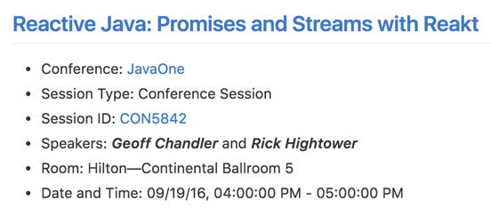
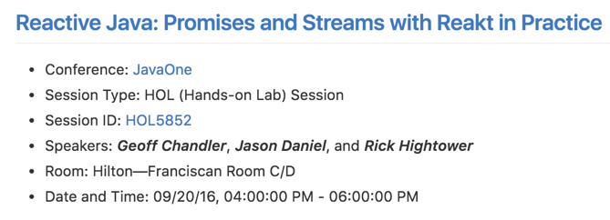
Related Talks

Slide 51
Conclusion
Streams and Batches to reduce thread hand-off and improve IO throughput
In-Memory, data-lease/ownership to increase throughput
Single writer
Lease with streams for failover and elasticity

Slide 52
Questions
?

Slide 53
Author Bio

Slide 54
Author Jason Daniel
Senior Director of Engineering NBC. Works with Spark, Kafka, Mesos, and reactive programming. Early contributor to QBit’s rough starts. Expert in RxJava and Vert.x.

Slide 55
Author Bio Rick Hightower
Rick frequently writes about and develops high-speed microservices. He focuses on streaming, monitoring, alerting, and deploying microservices. He was the founding developer of QBit and Reakt as well as Boon.
Notes:
Recently, Rick help develop many resilient, fault-tolerant microservices running in a Heroku clone based on Mesos in Scala and Java. He adapted QBit, microservice lib, so that when you drop in a service, it hooks into all of the 12 factor features that Orchard supports. QBit plugs into Orchard, port binding, DNS discovery, KPI stats, monitoring/distributed logging, health system, etc. Rick also wrote support for API gateway services via built-in Swagger support. This allows generation of service docs as well as REST clients for Python, Ruby, Java, Scala, etc. For the JVM, you also get WebSocket client which are auto generated runtime stubs which can invoke 500K method calls (request response) over WebSocket a second (per thread). Rick also wrote the OAuth rate limiter microservice which does OAuth rate limiting by application id and service load balancing for another online media services. Before that Rick wrote a 100 million-user in-memory content preference engine microservice for a large media company with custom NoSQL service store (2014) as part of this effort he wrote high speed JSON REST/WebSocket framework for reactive computing model based on Boon and Vert.x (and a disk batcher capable of writing 720 MB per second—the disk batcher was later used by Beats). Rick wrote over 150,000+ lines of open source code in 2013 – 2016. Rick also contributed to the reference implementations of Grid Computing and enterprise caches as well as being a member of several spec. committees (JSR-347, JSR-107, etc.) Rick is the primary author of Boon, SlumberDB and QBit. Rick is author of the best-selling book Java Tools for Extreme Programming (#1 SW development book on Amazon for 3 months) and other books. Rick also wrote a book on Python that covered programming and OO basics which was used as college text for introduction to programming and software development. Rick setup computer science programs at an elementary school and taught classes for three years. "Rick has the distinction of writing the single most popular article/series ever published on the Java technology zone." --Jenni Aloi, IBM DeveloperWorks. Rick also wrote a book on Java Web Development, which is the number one download on TheServerSide.com, and he wrote about NoSQL and scalability on InfoQ, and was the NoSQL editor for a short period of time. Prior to becoming a consultant, Rick helped create a startup that hosted 2,000 online stores on commodity hardware.

